Slide 1

3D-μNMADs 3D Nanofiber-based Microfluidic Analytical Devices <Literature Review>
Osamu Katagiri-Tanaka A01212611@itesm.mx
28 Oct 2020

Slide 2
Agenda
<a point for discussion> : <5min
<another point for discussion> : ~20min

Slide 3
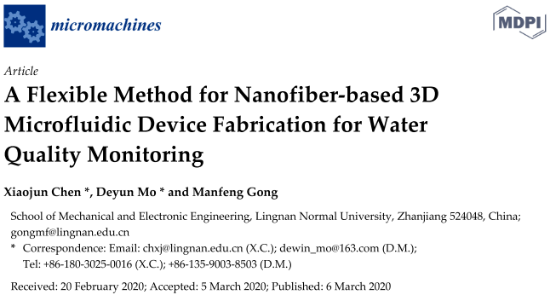
nanofibers + microfluidic chips + sensors + electrospinning
X. Chen, D. Mo, M. Gong, A Flexible Method for Nanofiber-based 3D Microfluidic Device Fabrication for Water Quality Monitoring, Micromachines. 11 (2020) 276. https://doi.org/10.3390/mi11030276.

Slide 4
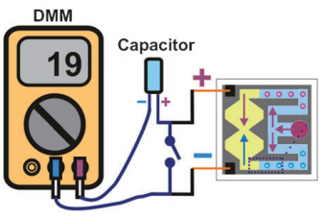
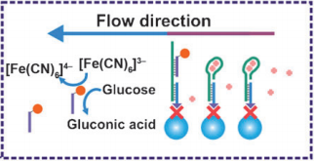
Applications:
3D-μNMADs
Environmental monitoring
Water quality testing
Health care
Glucose & protein detection
Mercury ions sensing
Detection of heavy metals
e.g. by Liu et al.
Liu, H., Xiang, Y., Lu, Y., & Crooks, R. M. (2012). Aptamer-Based Origami Paper Analytical Device for Electrochemical Detection of Adenosine. Angewandte Chemie International Edition, 51(28), 6925–6928. doi:10.1002/anie.201202929

Slide 5
Fabrication techniques (state-of-the-art):
2D structures
photolithography
spray printing
paper cutting
inkjet printing
screen printing
3D structures
2D stacking
paper origami
Well know techniques,
Simple & Easy to implement
Increased functionality & Fewer geometry limitations
vs.

Slide 6
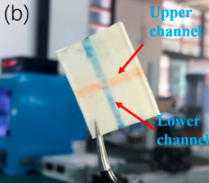
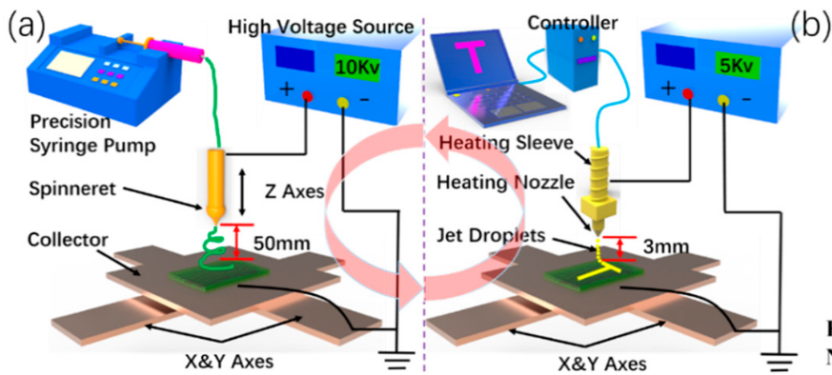
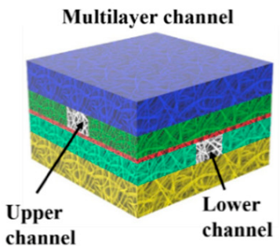
Materials and Methods:
FFES ink: polyimide (PI) and silicon powder (Si)
in dimethylacetamide (DMAc)
melt-NFES: wax

Slide 7
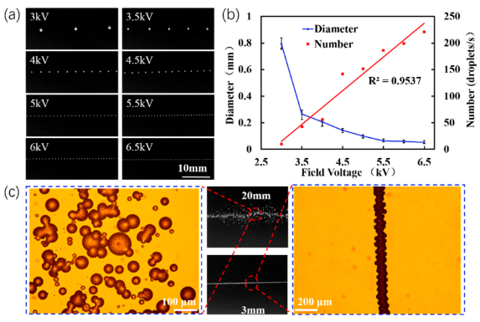
Process parameters (applied voltage & working distance):
“NFES wax printing is an atomization process rather than a spinning process.”

Slide 8
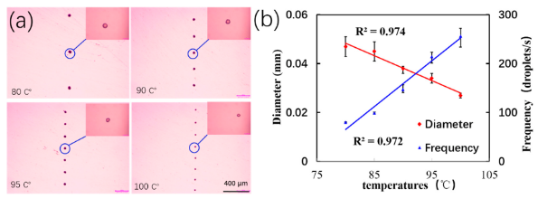
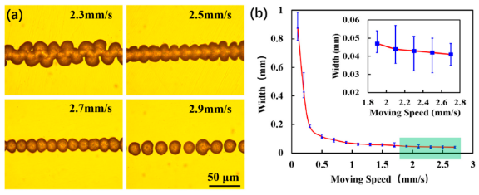
Process parameters (temperature & stage velocity):

Slide 9
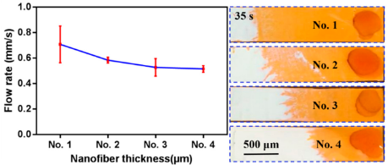
Performance of 3D-μNMADs:
Thin fibre mat
Thick fibre mat
“Faster flow rates were observed in thin membranes.”
Membrane porosity decreased and became denser after a long deposition time (No. 4), which resulted in a reduced flow.

Slide 10



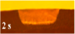
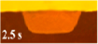
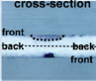
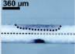
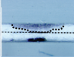
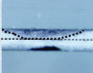
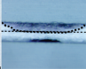
Conclusions:
Wax spreading can be controlled by the alignment of the electrospun nanofibers
Nanofiber‐based (this paper)
Inkjet printing (Carrilho et al.)
Carrilho, E., Martinez, A. W., & Whitesides, G. M. (2009). Understanding Wax Printing: A Simple Micropatterning Process for Paper-Based Microfluidics. Analytical Chemistry, 81(16), 7091–7095. doi:10.1021/ac901071p

Slide 11
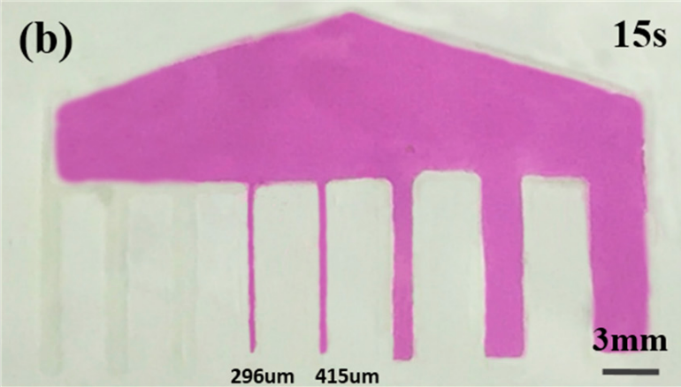
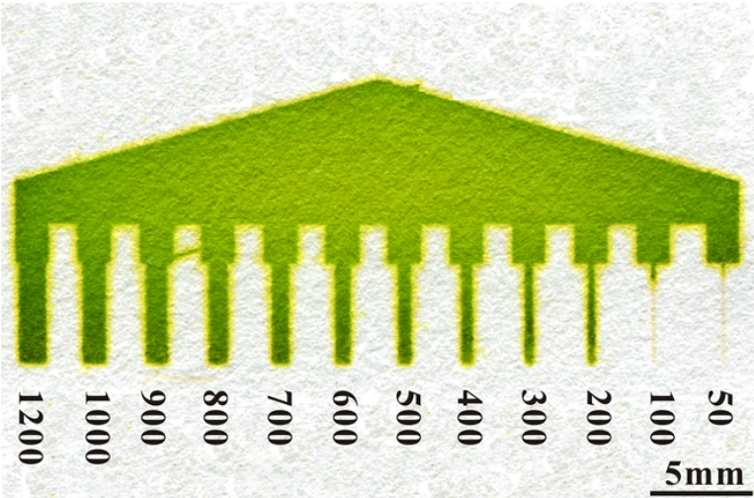
Conclusions (resolution):
Nanofiber‐based (this paper)
Photolithography (He et al.)
Dungchai, W., Chailapakul, O., & Henry, C. S. (2011). A low-cost, simple, and rapid fabrication method for paper-based microfluidics using wax screen-printing. The Analyst, 136(1), 77–82. doi:10.1039/c0an00406e
He, Q., Ma, C., Hu, X., & Chen, H. (2013). Method for Fabrication of Paper-Based Microfluidic Devices by Alkylsilane Self-Assembling and UV/O3-Patterning. Analytical Chemistry, 85(3), 1327–1331. doi:10.1021/ac303138x

Slide 12
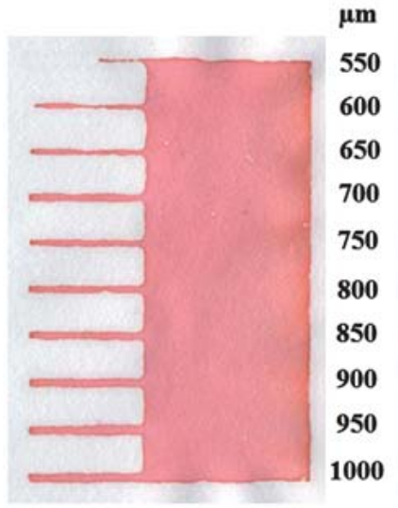
Conclusions (resolution):
Nanofiber‐based (this paper)
Screen printing (Dungchai et al.)
Dungchai, W., Chailapakul, O., & Henry, C. S. (2011). A low-cost, simple, and rapid fabrication method for paper-based microfluidics using wax screen-printing. The Analyst, 136(1), 77–82. doi:10.1039/c0an00406e
He, Q., Ma, C., Hu, X., & Chen, H. (2013). Method for Fabrication of Paper-Based Microfluidic Devices by Alkylsilane Self-Assembling and UV/O3-Patterning. Analytical Chemistry, 85(3), 1327–1331. doi:10.1021/ac303138x

Slide 13


Slide 14
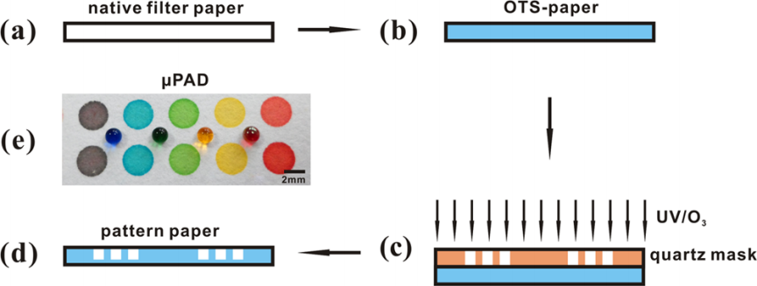
Photolithography
He, Q., Ma, C., Hu, X., & Chen, H. (2013). Method for Fabrication of Paper-Based Microfluidic Devices by Alkylsilane Self-Assembling and UV/O3-Patterning. Analytical Chemistry, 85(3), 1327–1331. doi:10.1021/ac303138x

Slide 15
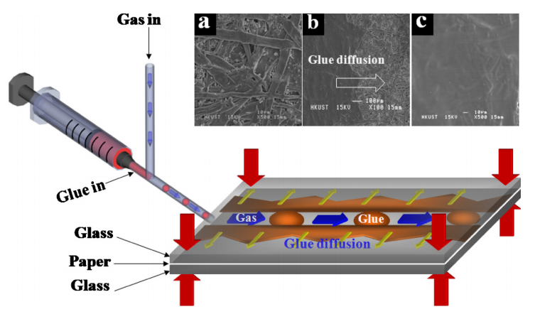
Paper cutting
Yi, X., Kodzius, R., Gong, X., Xiao, K., & Wen, W. (2010). A simple method of fabricating mask-free microfluidic devices for biological analysis. Biomicrofluidics, 4(3), 036503. doi:10.1063/1.3487796

Slide 16
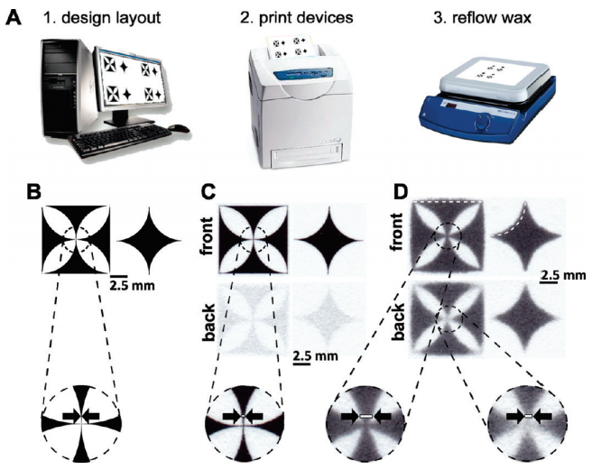
inkjet printing
Carrilho, E., Martinez, A. W., & Whitesides, G. M. (2009). Understanding Wax Printing: A Simple Micropatterning Process for Paper-Based Microfluidics. Analytical Chemistry, 81(16), 7091–7095. doi:10.1021/ac901071p

Slide 17
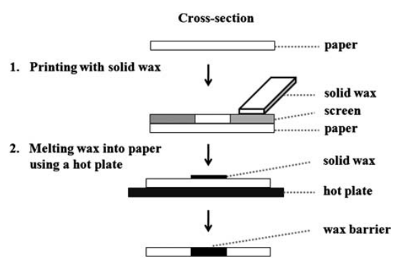
Screen printing
Dungchai, W., Chailapakul, O., & Henry, C. S. (2011). A low-cost, simple, and rapid fabrication method for paper-based microfluidics using wax screen-printing. The Analyst, 136(1), 77–82. doi:10.1039/c0an00406e

Slide 18
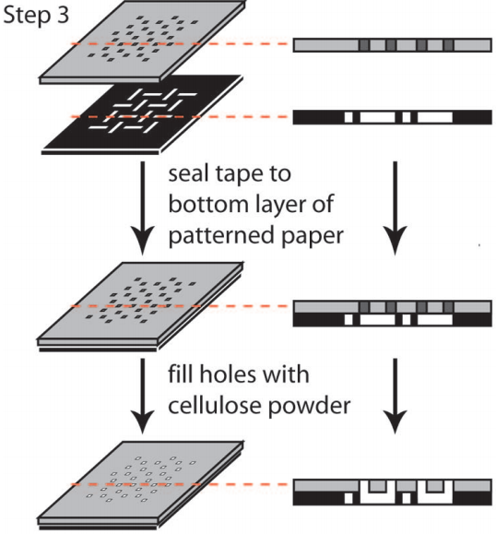
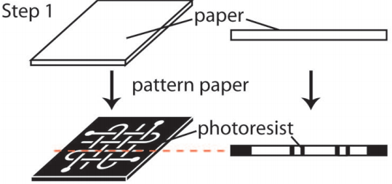
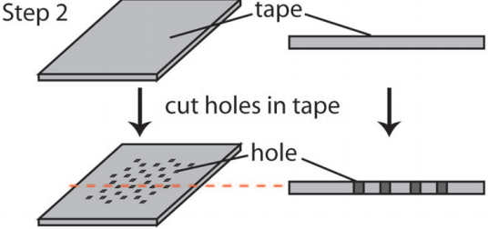
2D stacking
Martinez, A. W., Phillips, S. T., & Whitesides, G. M. (2008). Three-dimensional microfluidic devices fabricated in layered paper and tape. Proceedings of the National Academy of Sciences, 105(50), 19606–19611. doi:10.1073/pnas.0810903105

Slide 19
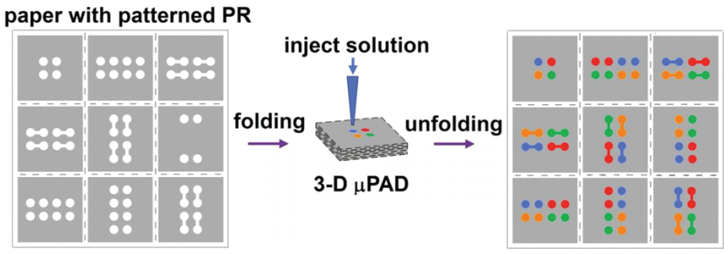
Paper origami
Liu, H., & Crooks, R. M. (2011). Three-Dimensional Paper Microfluidic Devices Assembled Using the Principles of Origami. Journal of the American Chemical Society, 133(44), 17564–17566. doi:10.1021/ja2071779

